Slide 1
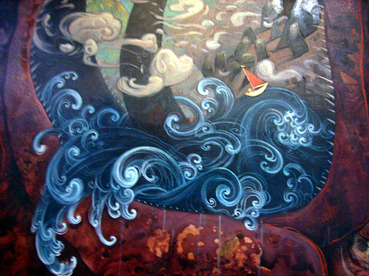
Visual Literacy…
Understanding the terms and techniques appropriate to visual texts…

Slide 2
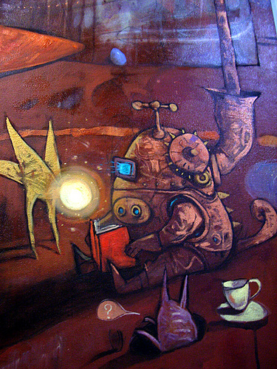
What is a ‘Visual Text’?
A visual text is a resource that contains images and/or elements of design.
Let’s brainstorm some visual texts or picture books... -My favourite is ‘Where’s Wally!’

Slide 3
Terms & Techniques:
Vectors
Many images will have people, animals or even objects participating in some kind of action. In these images there are often lines that lead the eye, which we can call vectors. These vectors can be objects or parts of objects (such as arms, legs, a pole, the side of a house) or invisible lines, such as the direction of gaze from a person’s eye. They help construct the actions that are taking place.

Slide 4
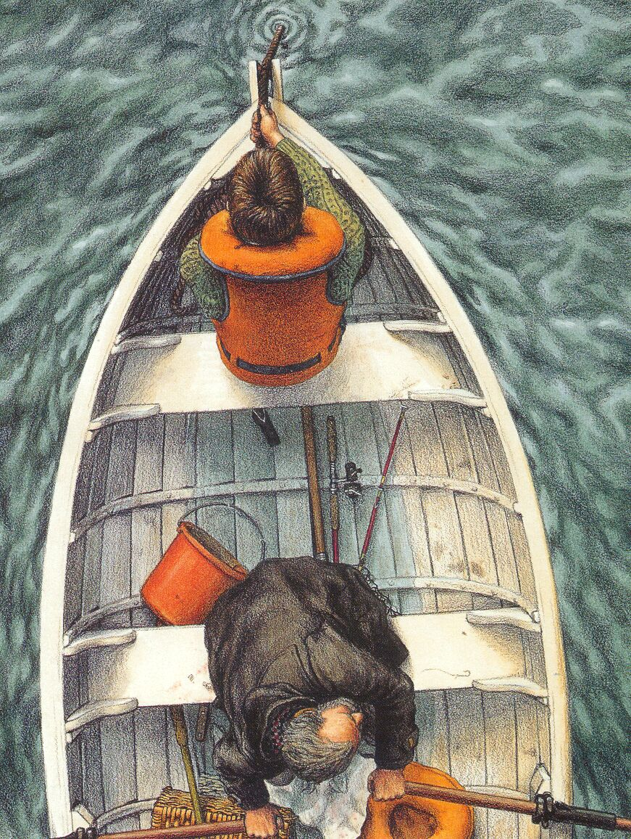
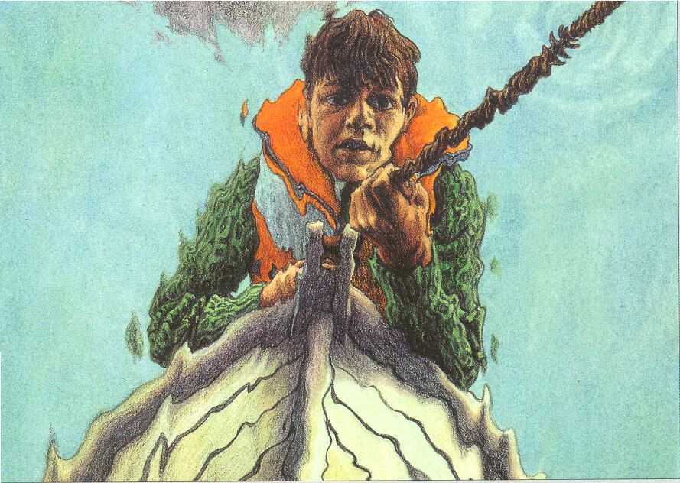
Terms & Techniques:
Angles
Looking down on someone or something from a height often conveys a sense of power or control. Conversely, looking up from below at a person or object can make us feel vulnerable. The use of ‘angles’ in images allows different relationships between people and between people and objects to be conveyed.

Slide 5
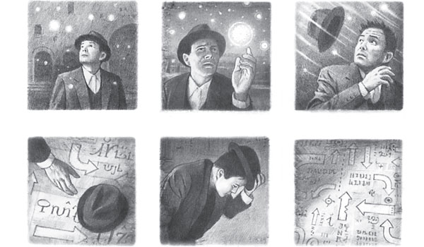
Terms & Techniques
Framing
An image can be framed in various ways. The frame determines the amount of information given to the viewer as well as sometimes signaling a social relationship with the viewer. For example, a close up or medium shot of a person can be attempting to portray them as though they are a friend. A long shot may portray them as though they are a stranger and distant from us.

Slide 6
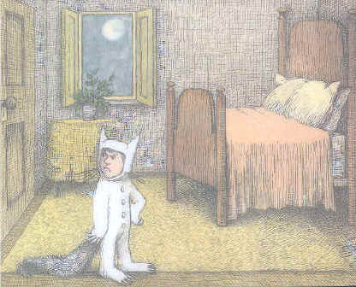
Terms & Techniques
Framing
The page itself is also a frame.
The illustrator decided what they would show the viewer in each of these frames.
Sometimes composers only use a small part of the page for illustrations and other times they use the whole page…

Slide 7
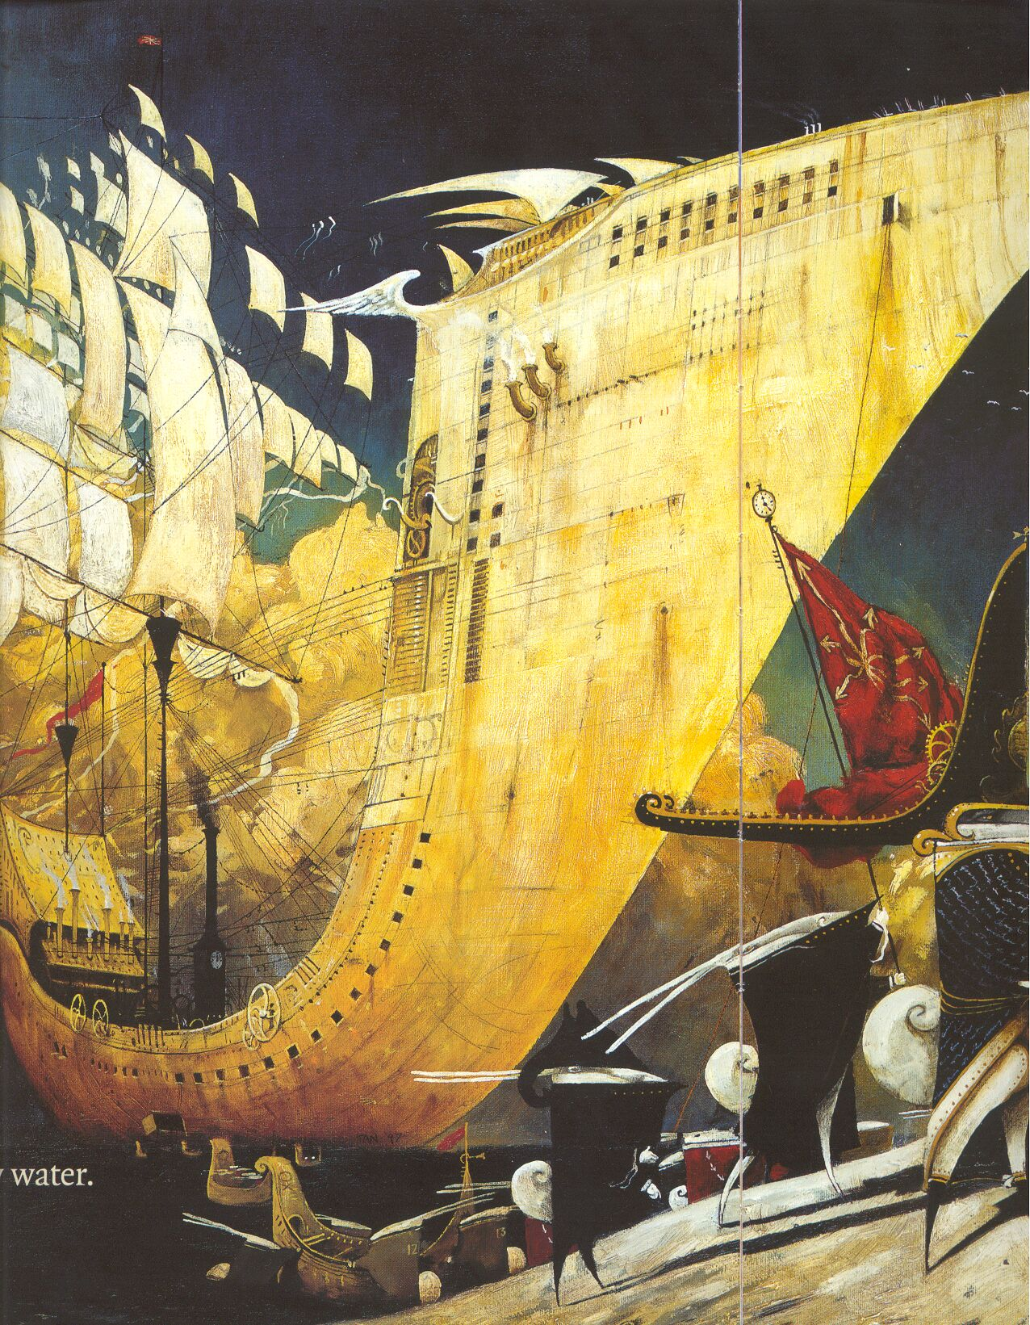
Terms & Techniques
Size
Consider the size of the objects or participants within an image or frame.
In this image of the invading force of rabbits from the book The Rabbits the frame is dominated by the size of the boat. It is suggested that the size of this invading force is enormous and unstoppable.

Slide 8
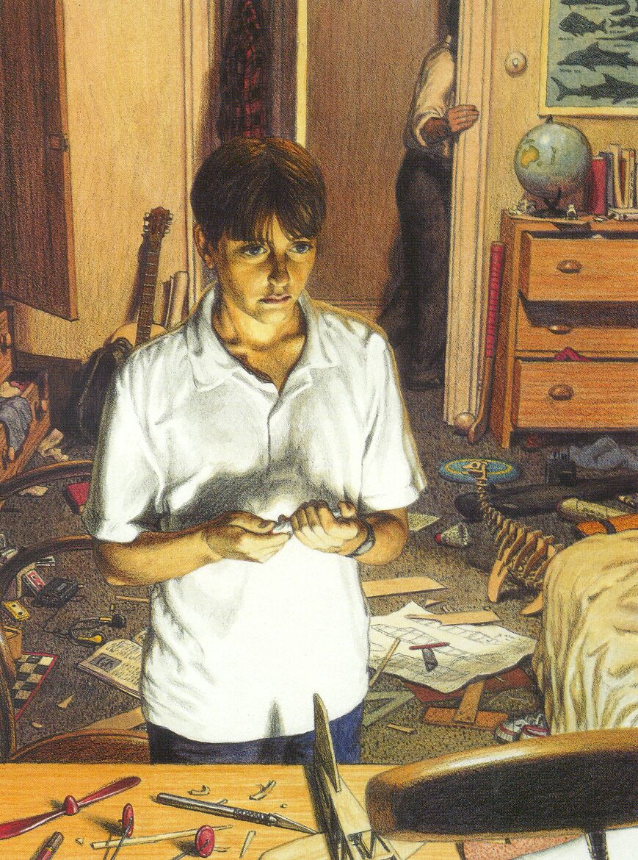
Terms & Techniques
Layout & Positioning
Layout refers to the illustration as a whole and where objects and participants are placed within the image. Positioning refers to how participants are depicted – e.g. facing the viewer / turned away from the viewer.
Look at the example to the left.
What is positioned at the front of this illustration? What could that be suggesting?
What is positioned at the back of this illustration? Why?

Slide 9
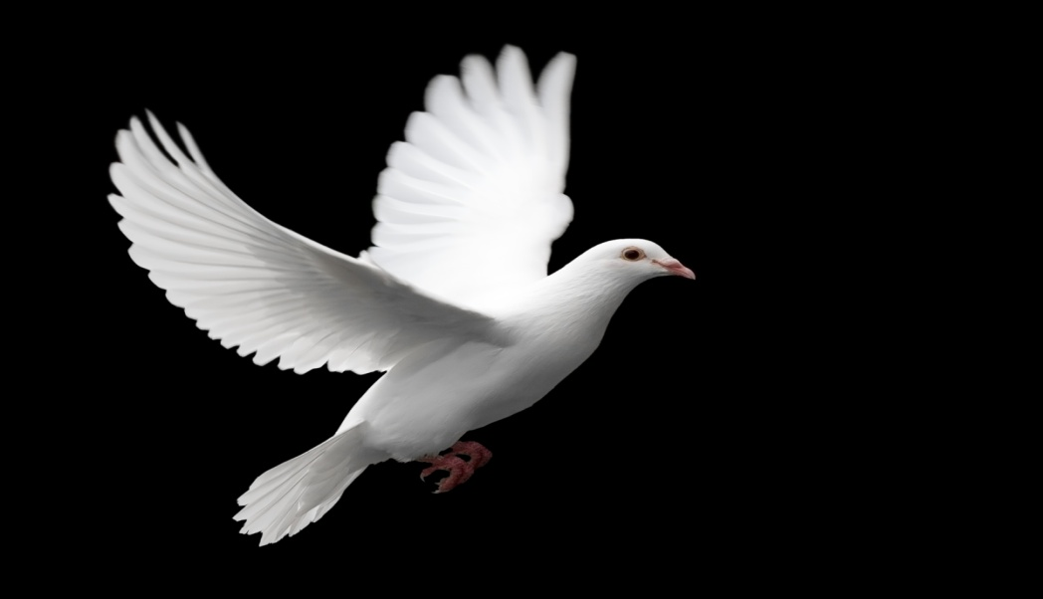
Terms & Techniques: Layout & Positioning
Symbols
These are objects that represent, stand for, or suggest an idea, belief or action. Symbols take the form of words, sounds, gestures, or visual images and are used to convey ideas and beliefs. E.g. an image of a dove is a well known symbol for peace.

Slide 10
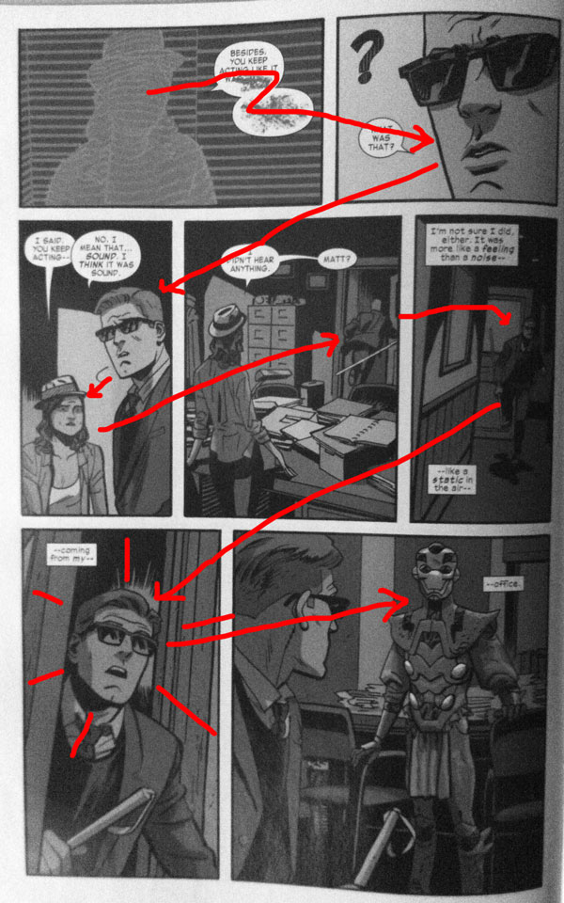
Terms & Techniques: Layout & Positioning
Reading Path
The reading path is the direction or path your eyes take through the salient elements of the image. Your path starts at the most salient images and then moves to other less salient images.

Slide 11
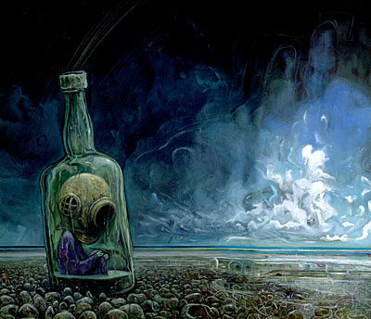
Terms & Techniques
Colour
Colour is used both to create convincing images and suggest particular moods or feelings.
What do you think each of these colours traditionally symbolise:
Red:
Pink:
Blue:
White:
Black:
Green:

Slide 12
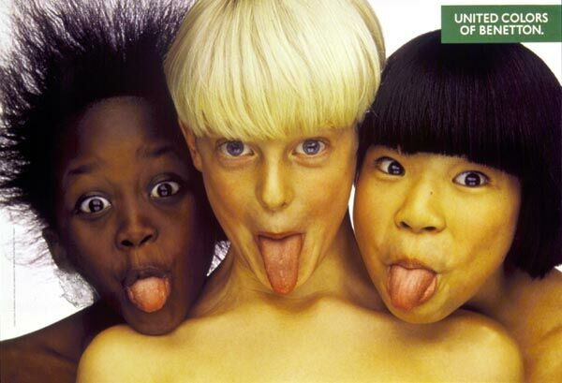
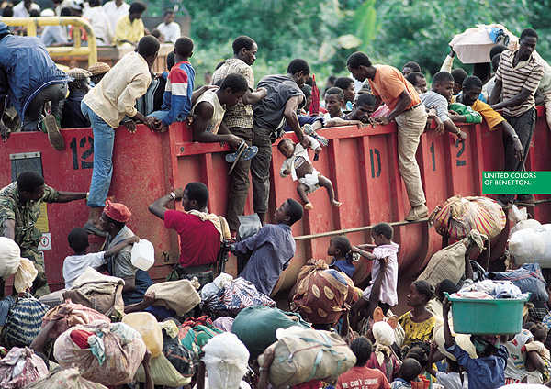
Terms & Techniques
Gaze
Gaze refers to the eyeline direction of participants within an image.
⬅Demand The character looks directly at the reader. The reader usually reacts in a certain way.
Offer ➔ The character does not make direct contact with the responder. The responder is not obligated to react in a certain way.

Slide 13
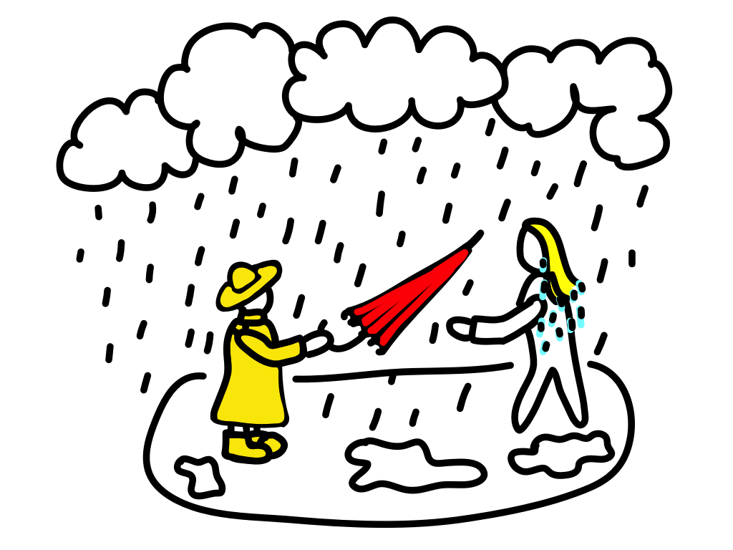
Salience
Salience- Salience refers to the impact a picture has on the reader at first glance. Salience is influenced by size, focus, colour, distance and placement.
High salience– the image draws your attention.
Low salience– you do not notice the image or are not drawn to it.

